Slide 1

Group 12 FINAL PROJECT bdat1004
Predictive Modeling for Nifty 50 Index Movements

Slide 2
PROJECT DESCRIPTION:
The project requires creating a sophisticated web application in Python using the Flask and Django frameworks using PyCharm in order to provide immersive visualizations of the Nifty 50 index data. The program will deliver dynamic charts, graphs, and interactive dashboards using data obtained from a web API, giving users a thorough understanding of Nifty's performance trends, sector breakdown, and historical patterns. Investors, traders, and market aficionados may easily obtain actionable insights through a user-centric interface, enabling them to make well-informed decisions. Modern visualization techniques have been used in the project to improve the accessibility of complex financial data as well as to promote better-informed investment decisions. This initiative ultimately acts as a link between data analytics and the stock market, enabling greater comprehension and strategic decision-making in the realm of Nifty50.

Slide 3
PROJECT TEAM MEMBERS:
RICHARD JOSHI(DEVELOPER): had B-TECH IN COMPUTER SCIENCE and pursuing a career in the field of data analytics. I was crucial in the development of the front-end and back-end parts of Nifty’s 50 data analysis, with the goal of providing visualizations while doing data analysis.
VINAYAK RAMACHANDRAN(PROJECT MANAGER): had a Bachelor’s in Physics, Mathematics, and Statistics and pursuing a career in the field of sports data analysis. In this position, I was in charge of overseeing the project's deliverables and worked closely with business analysts to produce thorough documentation for the data analytics program.
ANOOP PADAMATTUMAL(BUSINESS ANALYST): had a Bachelor’s in Physics, Mathematics, and Statistics and pursuing a career in the field of sports data analysis. I have reviewed the overview of Nifty’s 50 analysis and described the software’s purpose and goals, giving a detailed explanation of chosen technologies for front-end and back-end development.
NAVJEET KAUR (DATA ANALYST): had a Bachelor of Science (Physics, Chemistry, and Mathematics) and experience in the Department of Posts, India. In this project, I worked on acquiring Nifty-50 data, constructing data models, and designing a database to facilitate data analytics.

Slide 4
BUSINESS CASE:
In this project, the company is looking to find the stock price change in India, trying to fetch the high volumes for different stocks and which stocks do have higher or lower live prices, for finding meaningful insights for investing, trading, and having a deep knowledge of Nifty’s performance trends with an API data extracted from Rapid API link provided here: Latest Stock Price API Documentation (suneetk92) | RapidAPI. This is the API through which we have extracted Python and MongoDB codes and used PyCharm. For fulfilling the requirements of the Business case, we have added resolutions for this, creating a MongoDB connection after extracting data from API and then storing it in the database is required to build up visualizations. Flask, JINJA2, and PyCharm are used for building the website, then sorting out and representing the visualizations required for the questions to be answered for the company to gain an overall analysis of the Nifty stock market to invest in and trade wisely after looking up to current trends. Google charts and Javascript were used to visualize the data frameworks and queries extracted in the form of bar charts, line charts and pie charts on a web portal.

Slide 5
Tools Utilized for This Nifty Stock Market Project:
Python: The primary programming language for doing the backend code, creating API requests, getting connected with MongoDB, and running the Flask web application.
Flask: A micro web framework for Python used to create the web application and serve web pages.
MongoDB: This is a NoSQL database used to store the retrieved data taken from the Nifty stock market API.
HTML: Hypertext Markup language used to structure webpages content.
Jinja2: This is an engine used to generate HTML content and display API data from Python in HTML templates.
Javascript: This is a language used to integrate the Google Charts library and create interactive visualizations on the webpage.
Google Charts: A JavaScript library for creating data visualizations, such as line charts, bar charts and pie charts, and more.
PyCharm: An integrated development environment utilized for writing and running Python codes.
Terminal: Python scripts and the development server are managed via a command-line interface.

Slide 6
Project Flow
Fetching data from an API
Storing the fetched data into MongoDB Database using Python codes
Web application creation using Flask, HTML, Jinja2, and Visualization Using JavaScript and Google charts
Build a custom API

Slide 7
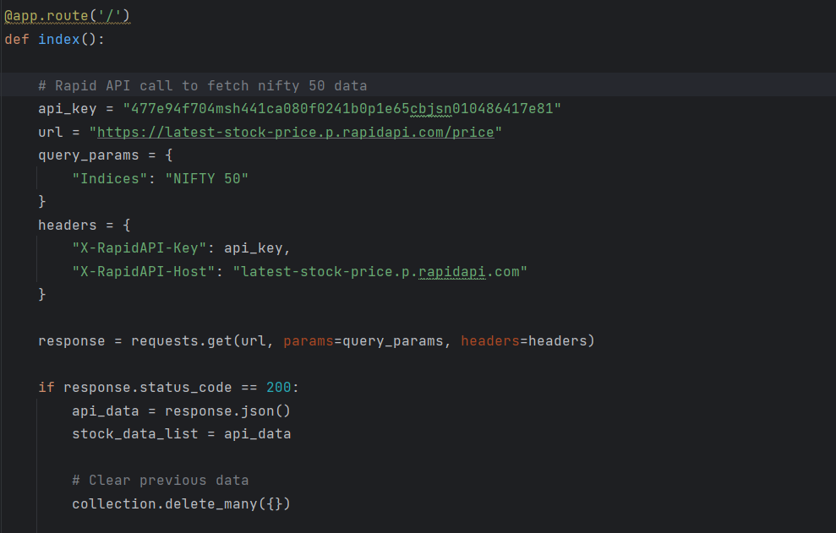
Fetching data from an API:

Slide 8
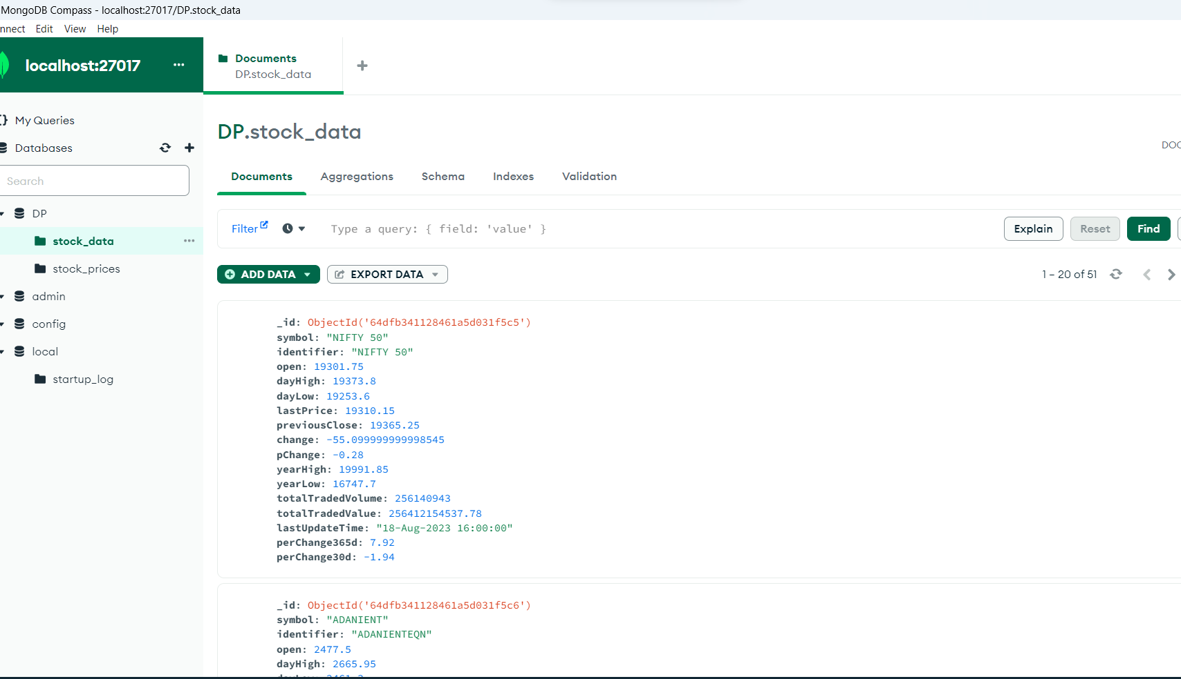
Storing the data into Mongodb database

Slide 9

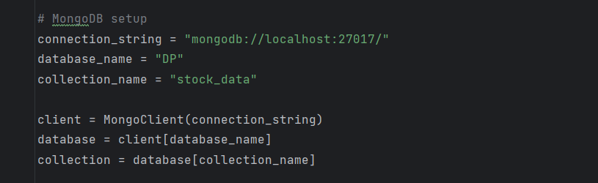
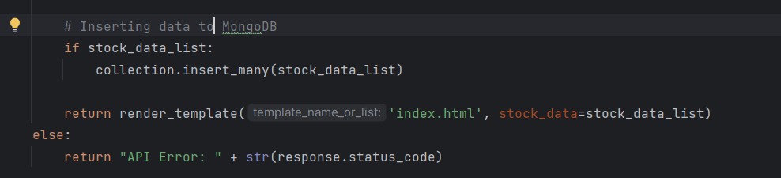
Storing the data into Mongodb database

Slide 10
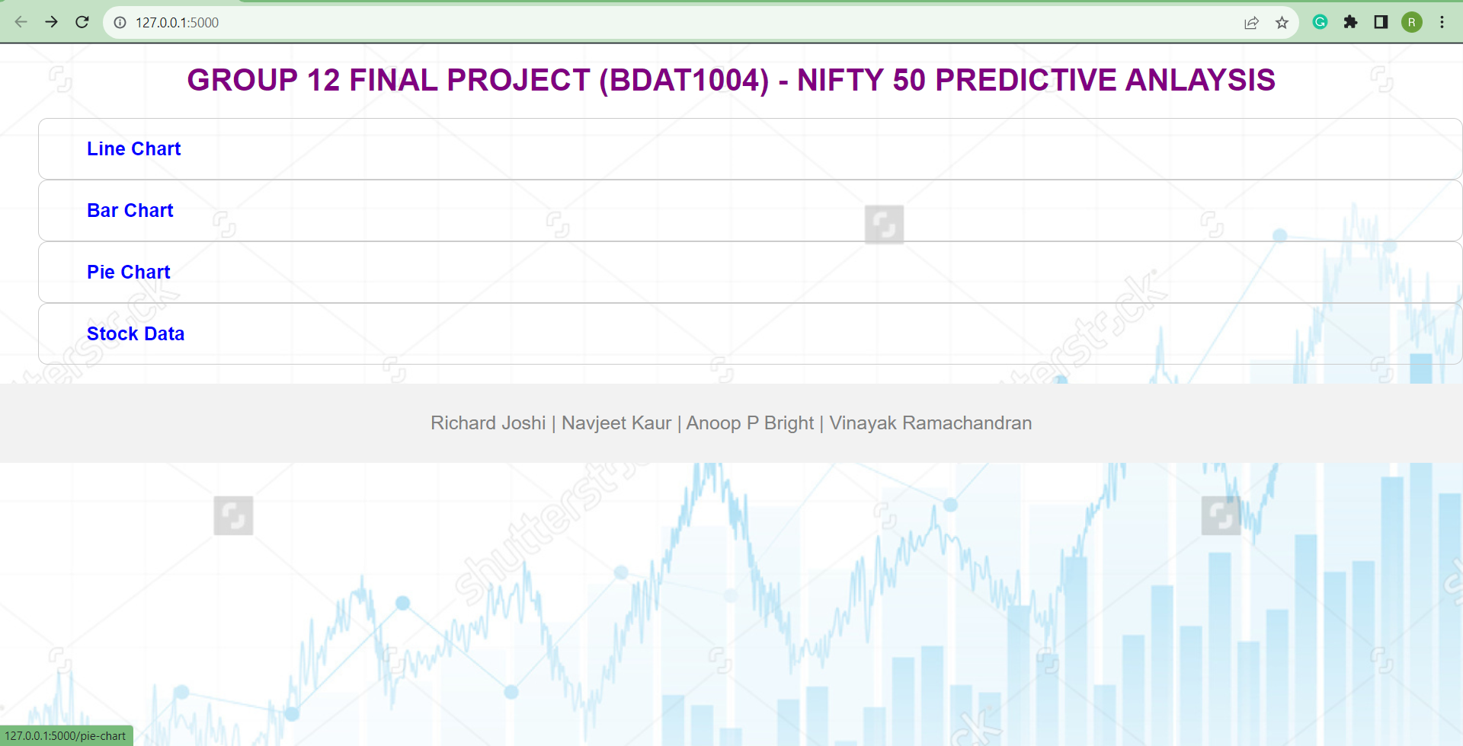
Data Visualization of the stock data
We have created a webpage to visualize the stock data.
We have also added some extra functionalities to the UI also

Slide 11
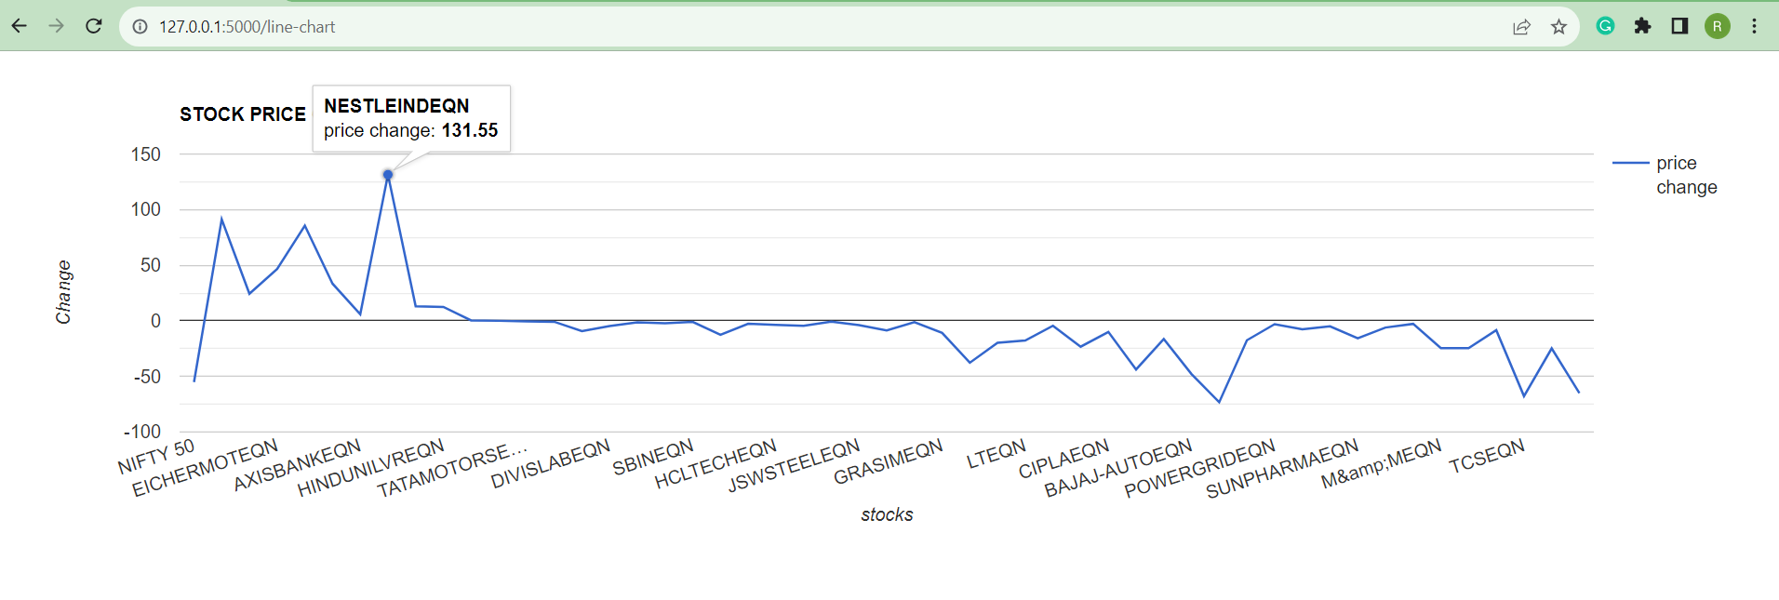
Line chart
If we move the curser to a particular stock we can see the change in its price too

Slide 12
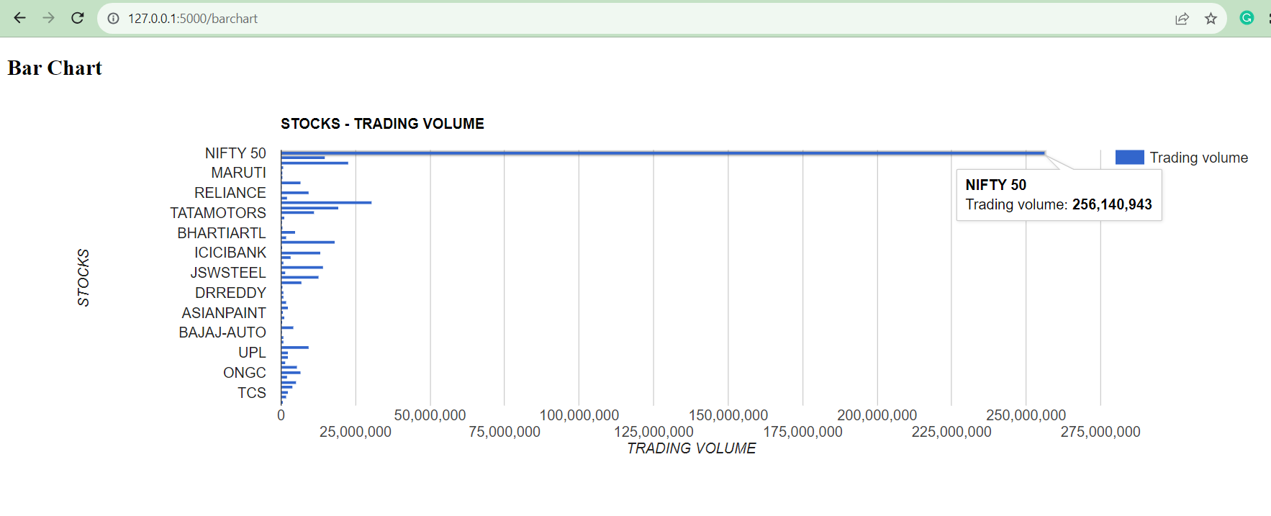
Bar chart
If you move to a particular stock line you can see the current trading volume of the stock

Slide 13
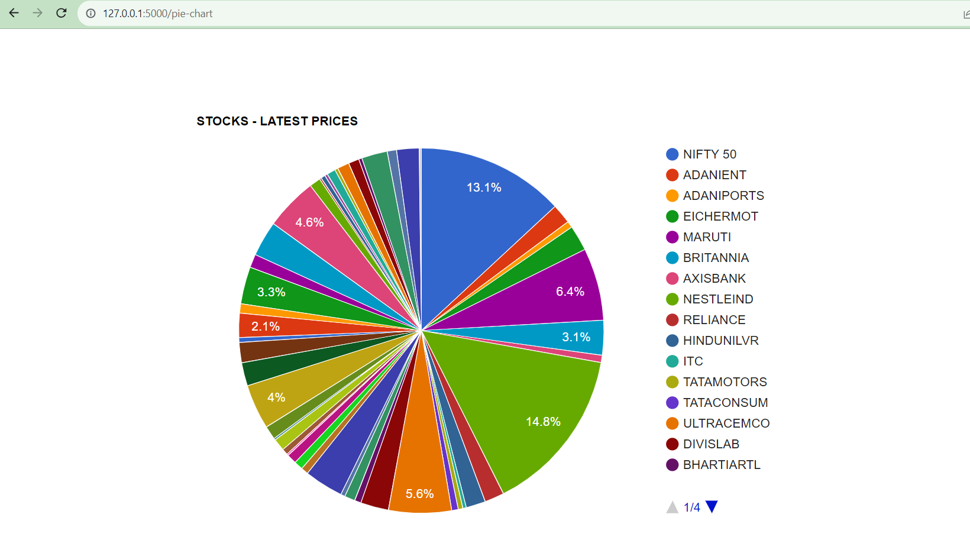
Pie chart
We can see all the latest updated prices of all the stocks as different colours in the pie chart

Slide 14
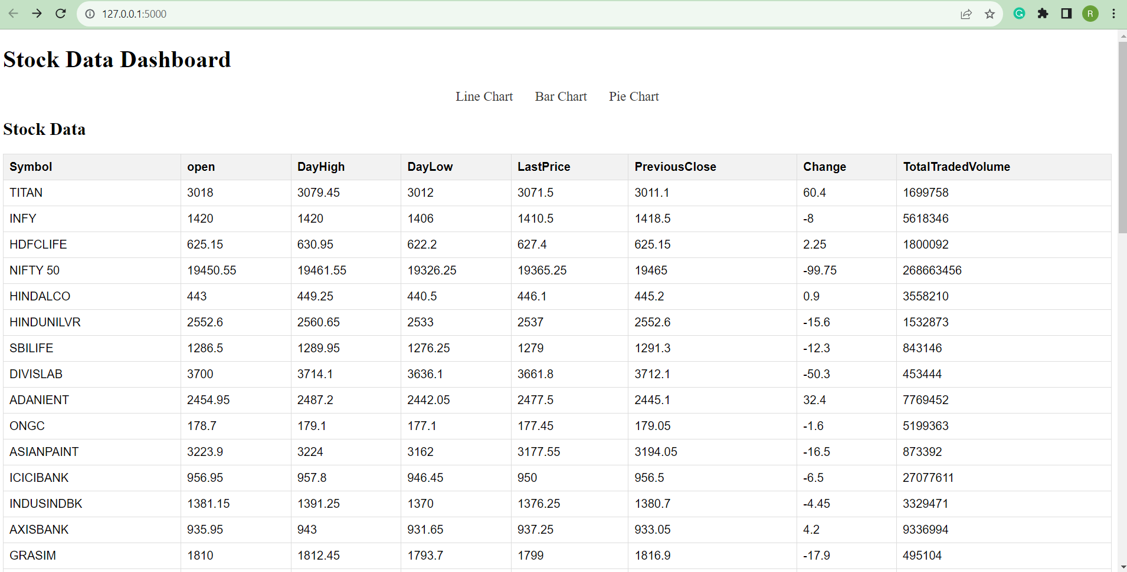
Stock data
We have also included a added functionality which shows the stock data of the stocks

Slide 15
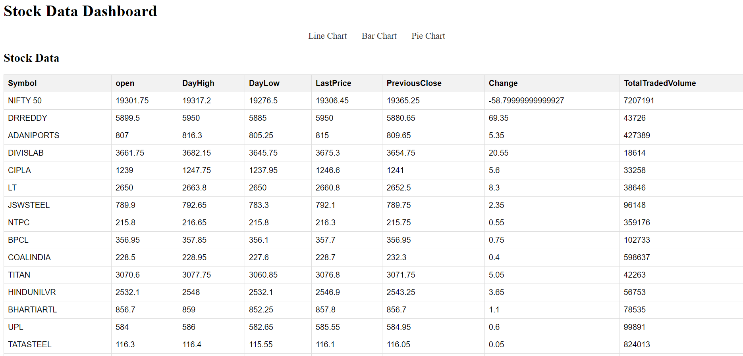
Stock data

Slide 16
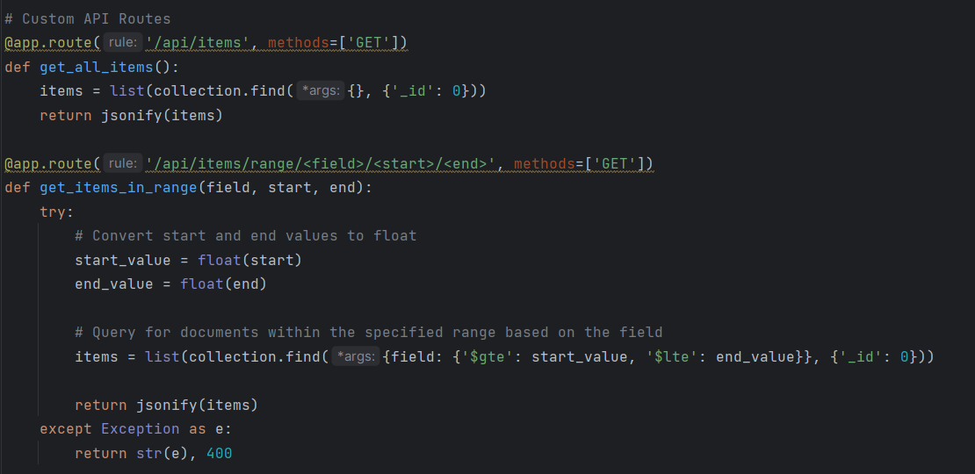
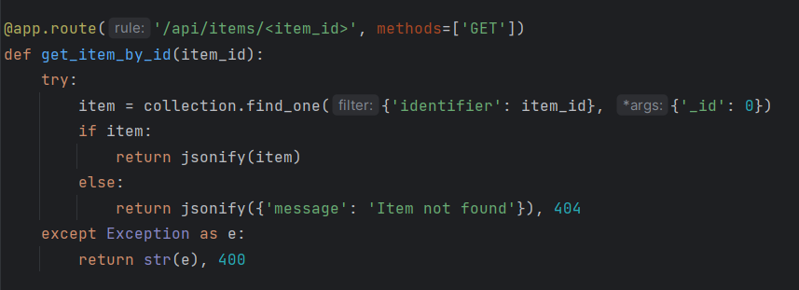
Building a custom API
We have also tried to built a custom API which gets all of the data, gets data by a range and gets item by an ID

Slide 17
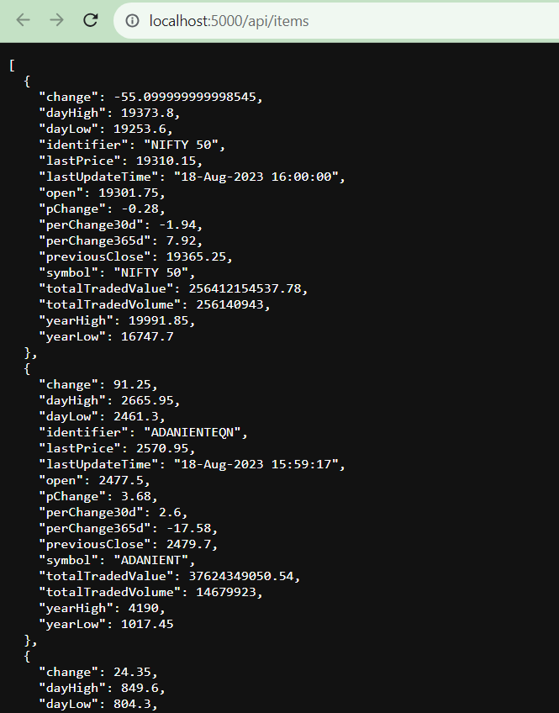
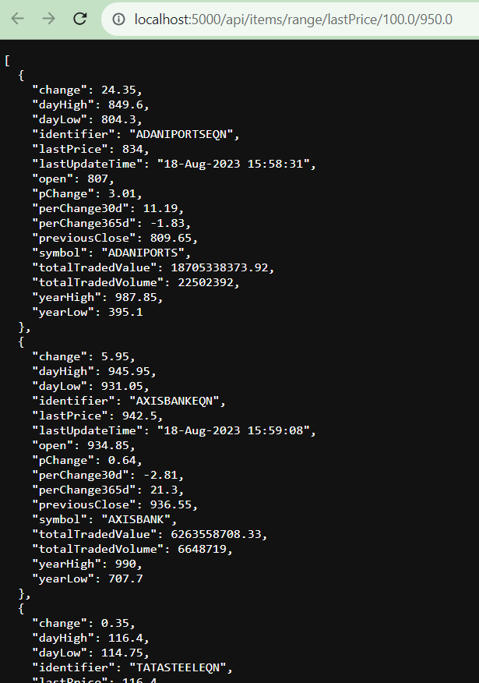
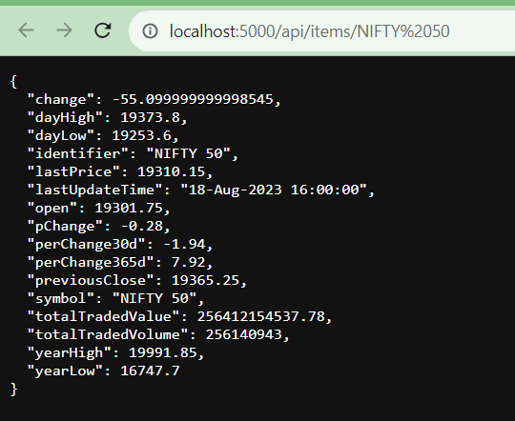
Getting data using the custom API
Getting all the data
Getting data for a range
Getting data of an ID

Slide 18
Thank you
Group 12 Members

